Slide 1
Supervised Learning - Classification
Personal loan campaign modelling Project
Submitted by:
Naveen Pusuluri

Slide 2
Objective:
Predict whether a liability customer will buy a personal loan or not.
Find out most significant variables.
Find out the target customer segment.
Data Information:
ID: Customer ID.
Age: Customer’s age in completed years.
Experience: No of years of professional experience.
Income: Annual income of the customer (in thousand dollars).
ZIP Code: Home Address ZIP code.
Family: the Family size of the customer.
CCAvg: Avg. spending on credit cards per month (in thousand dollars).
Education: Education Level. 1: Undergrad; 2: Graduate;3: Advanced/Professional.
Mortgage: Value of house mortgage if any. (in thousand dollars)
Personal_Loan: Did this customer accept the personal loan offered in the last campaign?
Securities_Account: Does the customer have securities account with the bank?
CD_Account: Does the customer have a certificate of deposit (CD) account with the bank?
Online: Do customers use internet banking facilities?
CreditCard: Does the customer use a credit card issued by Bank?
Observations | Variables
5000 | 13

Slide 3
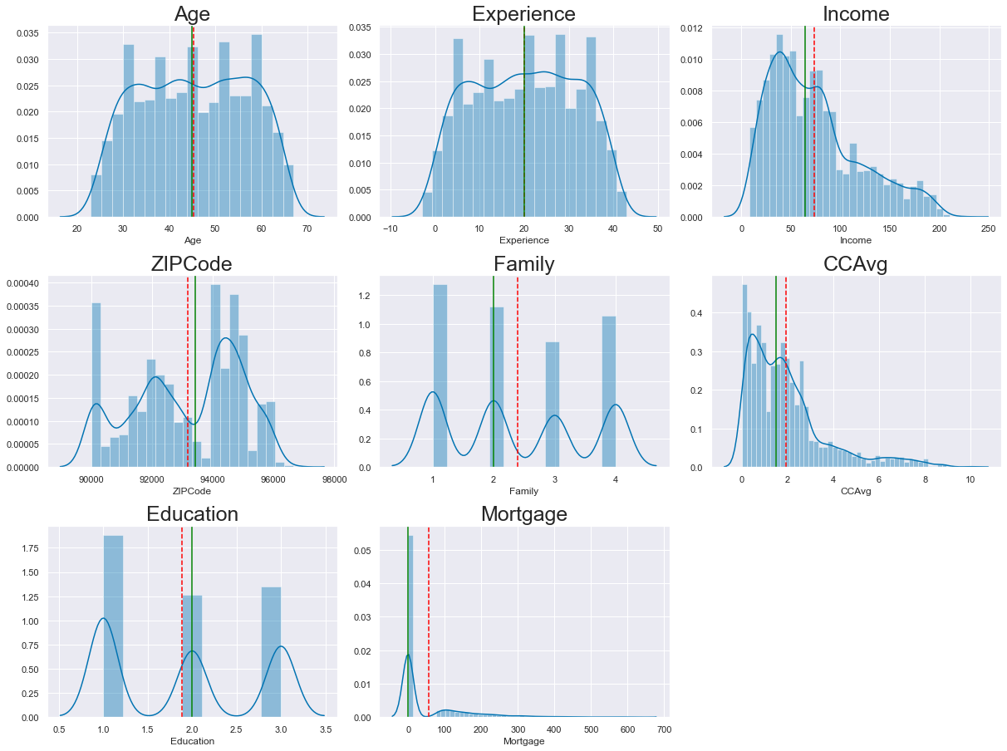
Exploratory Data Analysis:
Distribution of Numerical Variables
Observations:
Mean and median are identical in both Age and Experience variables, indicating some normal distribution.
Income variable is right skewed, indicating most of the customers are in between 8K and 100k Income.
The Income variable is right-skewed, indicating most of the customers are between 8K and 100k Income.
CCAvg and Mortgage variables are also right-skewed.

Slide 4
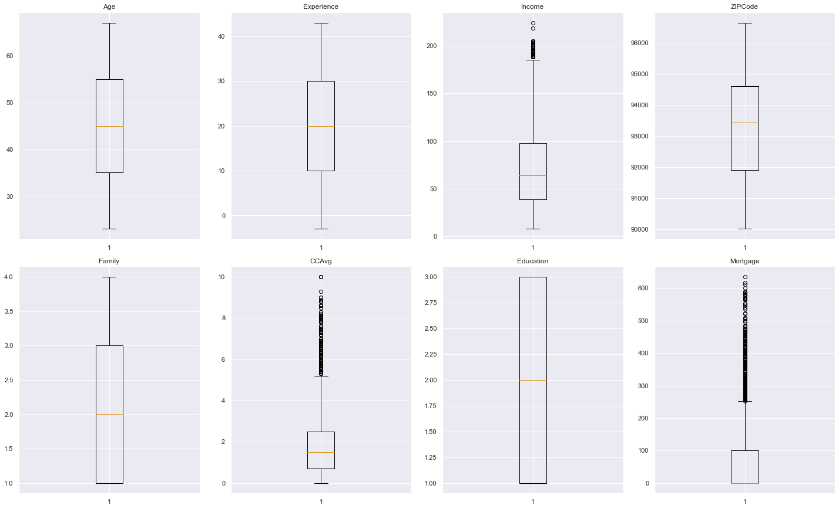
Exploratory Data Analysis:
Distribution of Numerical Variables
Observations:
Income, CCAvg and Mortgage variables have outliers and need to treat before building the model

Slide 5
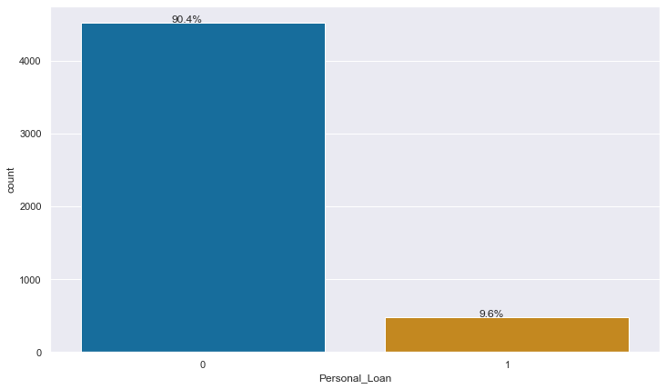
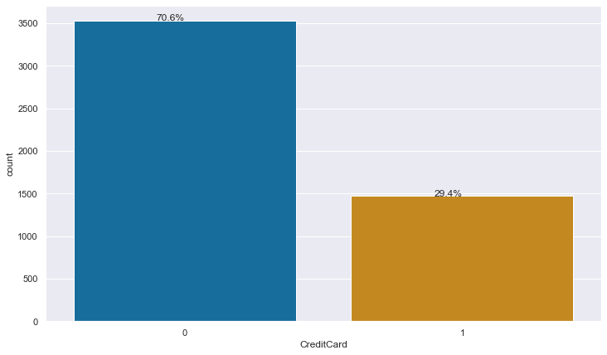
Exploratory Data Analysis:
Personal Loan
Credit Card
Observations:
Only 9.6% of the customers have accepted the personal loan in the last campaign.
Observations:
Only 29.4% of the customers are using bank issues credit cards.

Slide 6
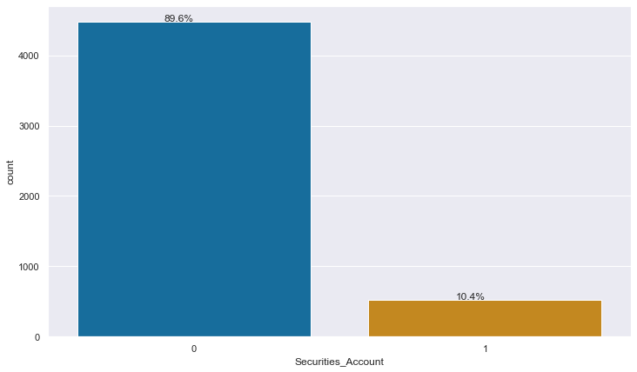
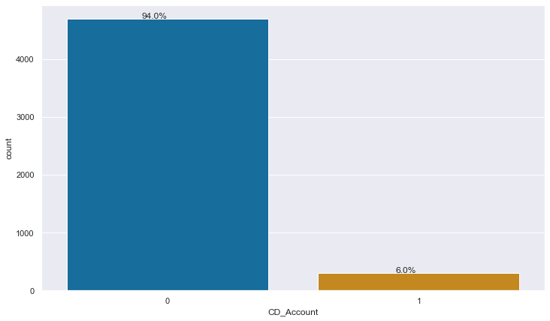
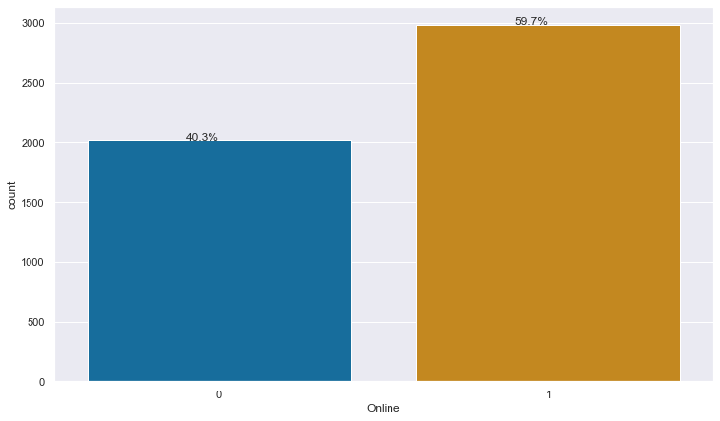
Exploratory Data Analysis:
Securities_Account
CD_Account
Online
Observations:
Only 10.4% of the customers have securities account with the bank.
Observations:
Only 6% of the customers have a Certificate of Deposit account with the bank.
Observations:
59.7% of the customers are using internet banking facilities.

Slide 7
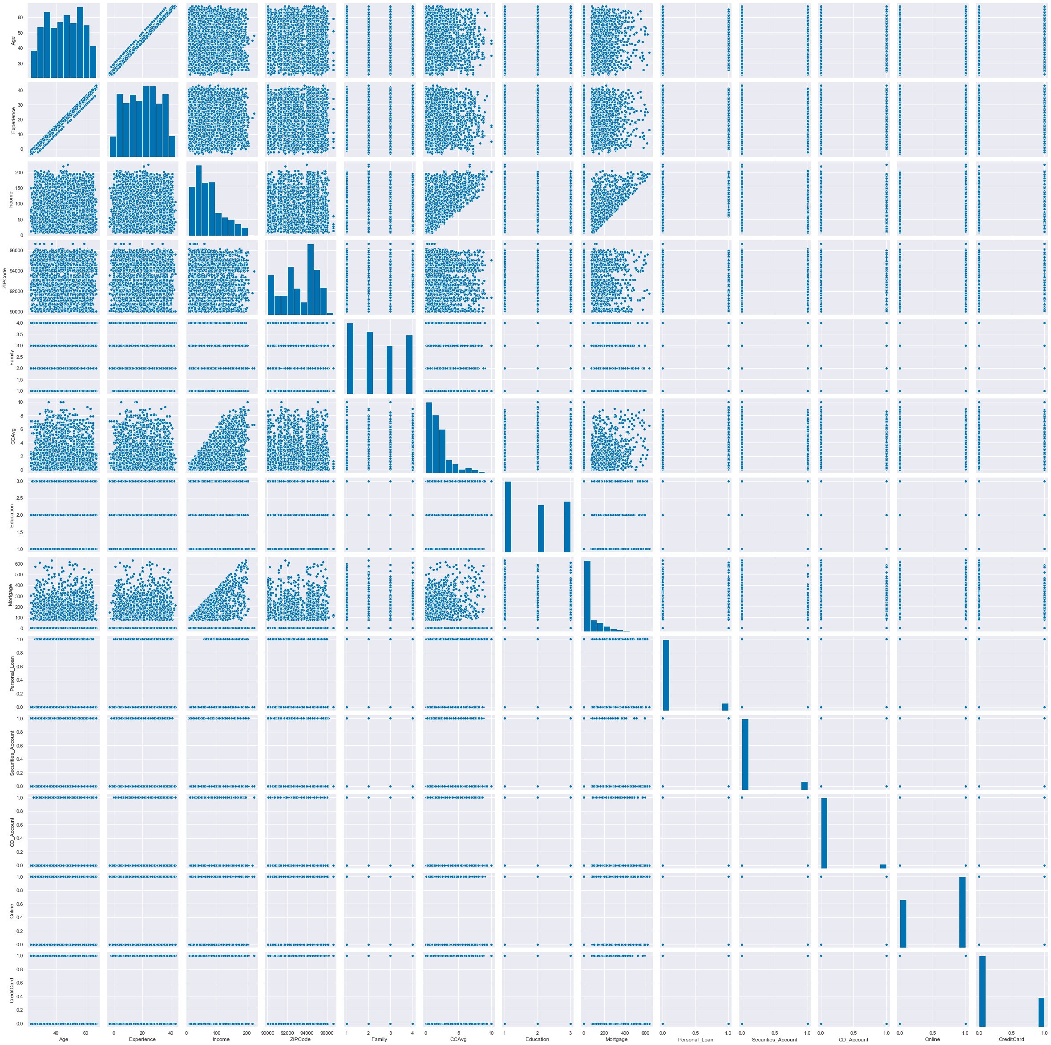
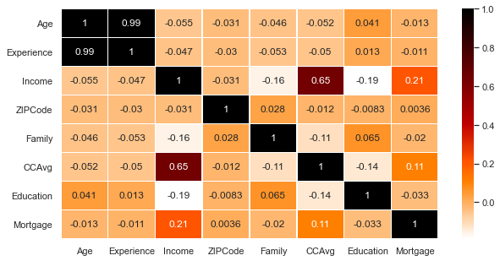
Exploratory Data Analysis:
Correlation Matrix
Observations:
Age and Experience variables are positively highly correlated.
Income and CCAvg also have a high correlation. However, it has very little correlation with Mortgage.

Slide 8
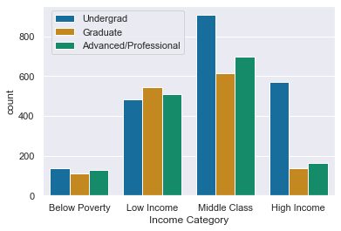
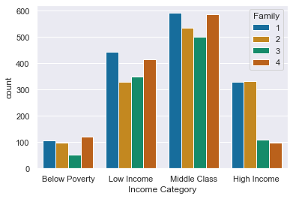
Exploratory Data Analysis:
Bivariate and Multivariate Analysis
Education VS Income
Income VS Family
Observations:
Most of the customers are belong to the middle-class income category, followed by low income, high income and below poverty income categories.
Except in the low-income category, undergraduate customers are high in the other three categories, followed by Advanced/Professional and Graduates.
Observations:
Customer's family size of one and four stood in first and second place in the middle-class income category.
In both High and below poverty income categories, customers' family sizes of one and two are equal in number.

Slide 9
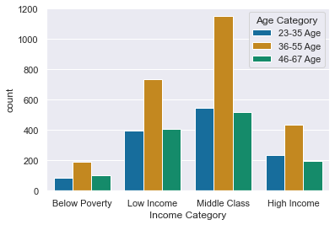
Exploratory Data Analysis:
Bivariate and Multivariate Analysis
Income VS Age
Age VS Family
Observations:
The majority of the bank customers are between the 36-55 age group in which most of them from the middle-class income category.
.
Observations:
The majority of customers in the age group, 36-55, are with a family size of one followed by a family size of two, four and three.

Slide 10
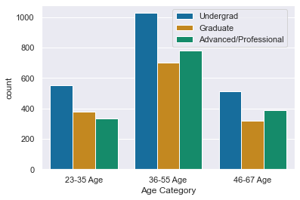
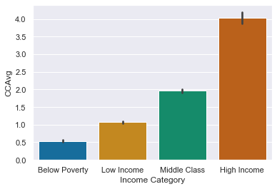
Exploratory Data Analysis:
Bivariate and Multivariate Analysis
Age VS Education
Income VS CCAvg
Observations:
The majority of customers in the age group, 36-67, are Undergraduates, followed by Advanced/Professional and Graduates.
The majority of customers in the age group, 23-35, are Undergraduates, followed by Graduates and Advanced/Professional.
Observations:
High-income category customers spend more on credit cards per month, followed by Middle-class, low-income, and below-poverty-income customers.

Slide 11
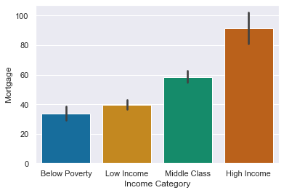
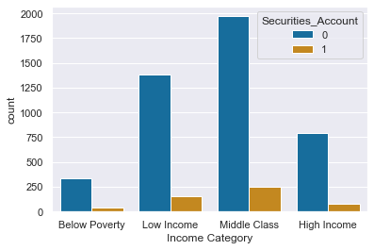
Exploratory Data Analysis:
Bivariate and Multivariate Analysis
Income VS Mortgage
Income VS Securities Account
Observations:
The majority of the customers with mortgages belong to the high-income category, followed by Middle-class, low-income, and below-poverty-income customers.
Observations:
The majority of customers do not have a Securities account with the bank. However, most customers who ever have a securities account with a bank belong to the middle-class income category.

Slide 12
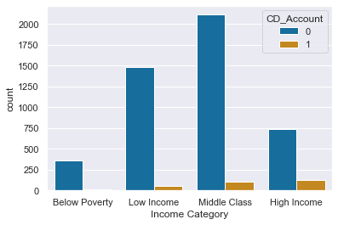
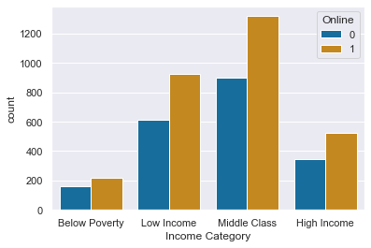
Exploratory Data Analysis:
Bivariate and Multivariate Analysis
Income VS CD_Account
Income VS Online
Observations:
The majority of customers do not have a CD_Account with the bank. However, most customers who ever have a CD_Account within the bank belong to the High-income category, followed by Middle class and low-income customers.
None of the below poverty income customers have a CD_Account in the bank.
Observations:
The majority of customers using online banking services. Most customers who use online banking services belong to the Middle-income category, followed by Low-income, High-income and below poverty customers.

Slide 13
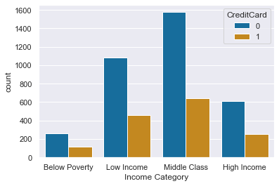
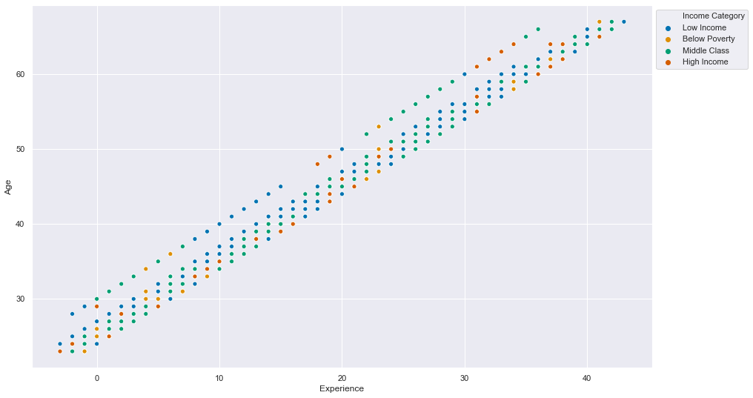
Exploratory Data Analysis:
Bivariate and Multivariate Analysis
Income VS CreditCard
Age VS Experience VS Income
Observations:
Among all income categories, Most customers who use bank-issued credit cards belong to middle-class income customers, followed by Low-income, High-income and below-poverty customers.
Observations:
As customer age increases, working experience is also increasing, indicating the customer's age has a very high correlation with customers working experience.

Slide 14
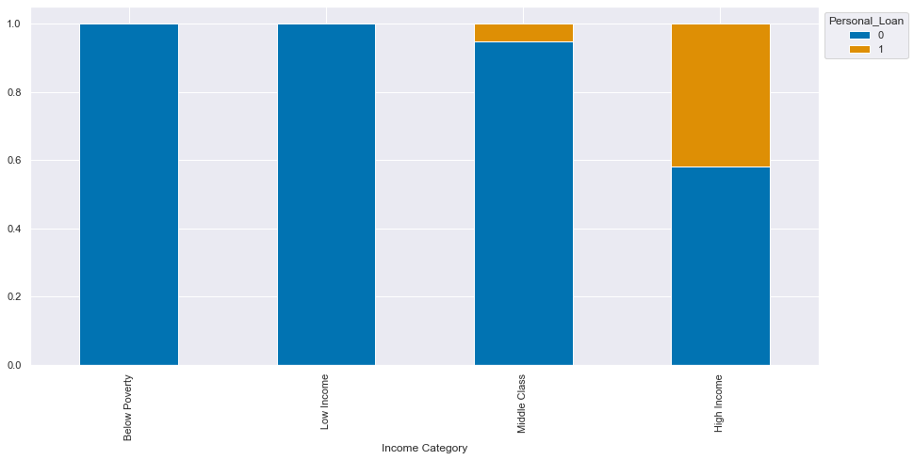
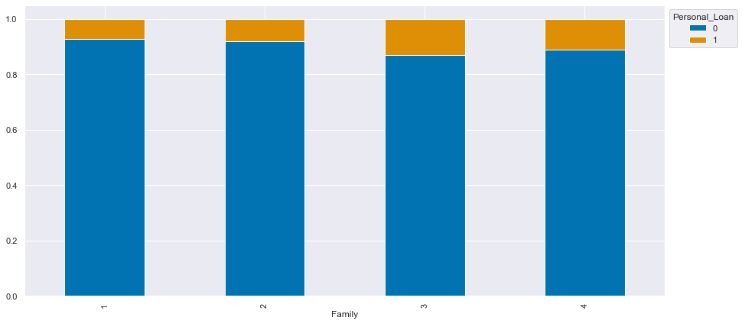
Exploratory Data Analysis:
Bivariate and Multivariate Analysis
Income Category VS Personal Loan
Family VS Personal Loan
Observations:
Among all the Income categories, customers with High-income and Low-income have a 25% likelihood of accepting the bank's default personal loan.
It seems Low-income and Below-poverty income category customers are not interested in accepting banks' default personal loans.
Observations:
Among all the customer family sizes, customers with a family size of three and four have more likelihood of accepting the bank's default personal loan than the other two family sizes.

Slide 15
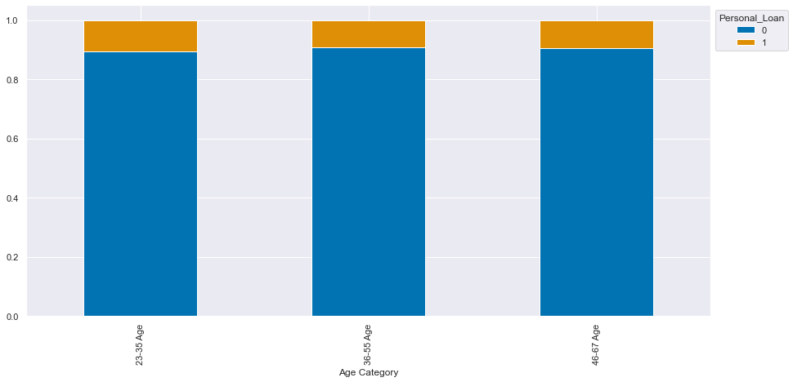
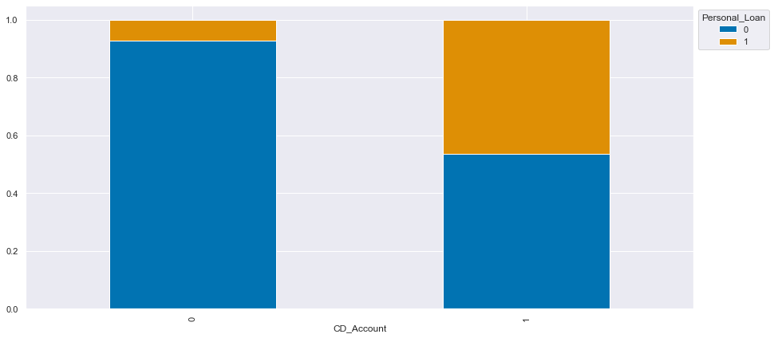
Exploratory Data Analysis:
Bivariate and Multivariate Analysis
Age Category VS Personal Loan
CD_Account VS Personal Loan
Observations:
Customers with all aged groups have around a 10% likelihood of accepting the bank's default personal loan.
Observations:
Customers with CD_Account in the bank have around 47% likelihood of accepting bank's default personal loan, which is higher than non CD_Account holders.

Slide 16
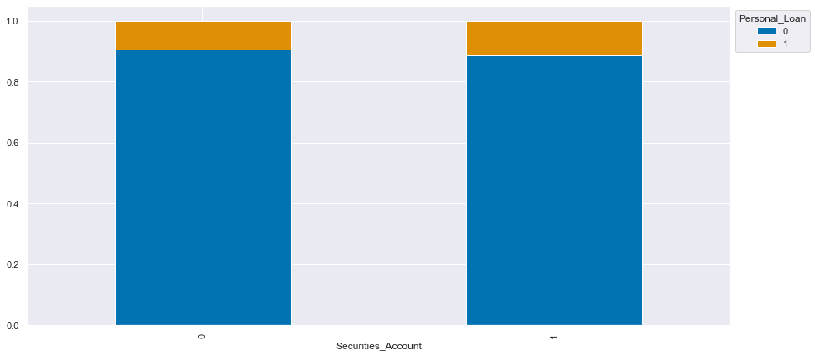
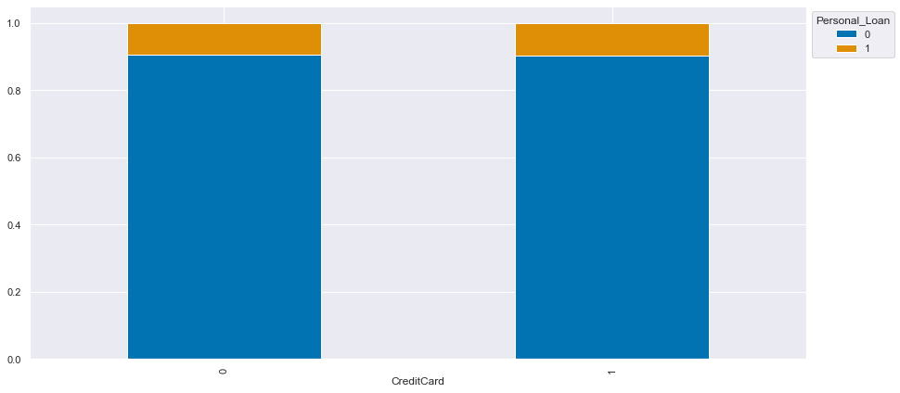
Exploratory Data Analysis:
Bivariate and Multivariate Analysis
Securities_Account VS Personal Loan
Credit Card VS Personal Loan
Observations:
Customers with Securities_Account in the bank have around 13% likelihood of accepting the bank's default personal loan, which is higher than non Securities_Account holders.
Observations:
Customers using bank-issued credit cards and other credit card holders have an equal likelihood of accepting the bank's default personal loan.

Slide 17
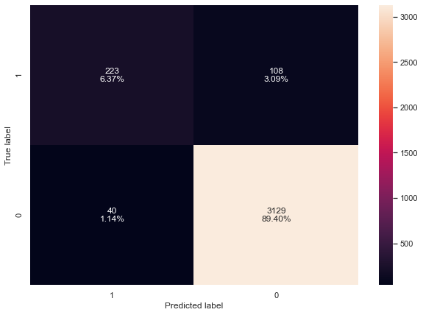
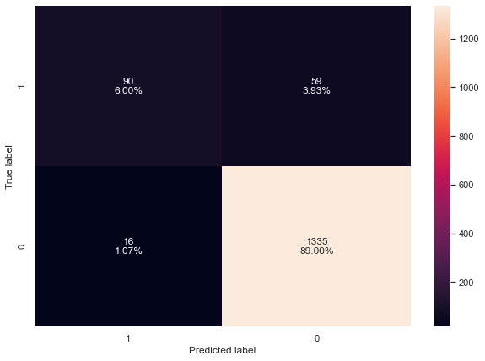
Logistic Regression Model
Target Dependent Variable : Personal_Loan
Independent Variables: Age, Experience, Income, Family, CCAvg, Education, Mortgage, Securities_Account, CD_Account, Online and CreditCard
Model Performance on Training data
Model Performance on Test data
Accuracy on train data: 0.9577142857142857
Accuracy on test data: 0.95

Slide 18
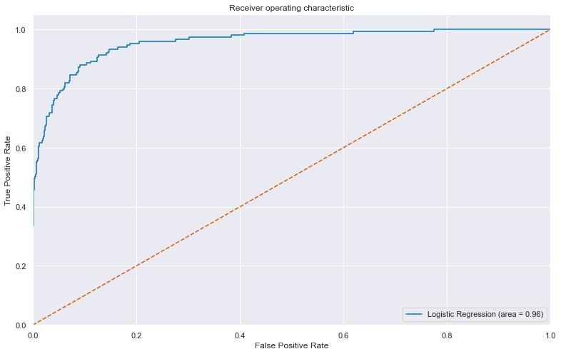
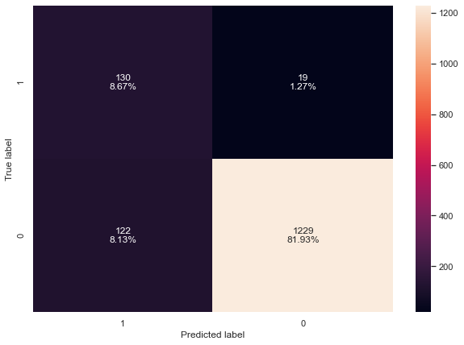
Logistic Regression Model
AUC Curve:
Model Performance with Optimal threshold
Accuracy with optimal threshold
Accuracy on train data: 0.902
Accuracy on test data: 0.906
Observations:
After using optimal threshold we see that true positives have increased from 6.37% to 8.67%. and false positive has decreased from 3.09% to 1.27%.

Slide 19
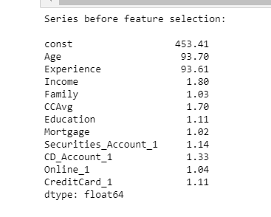
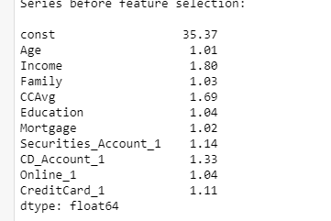
Logistic Regression Model
Check for multicollinearity by Variance Inflation Factor (VIF Score)
Observations:
. Age and Experience variables have a very high VIF score which indicated perfect collinearity.
Will check again VIF scores by dropping ‘Experience’ feature.
Observations:
After dropping of variable ‘Experience’, VIF has come down to quite a reasonable limit, now we can say features are not correlated.

Slide 20
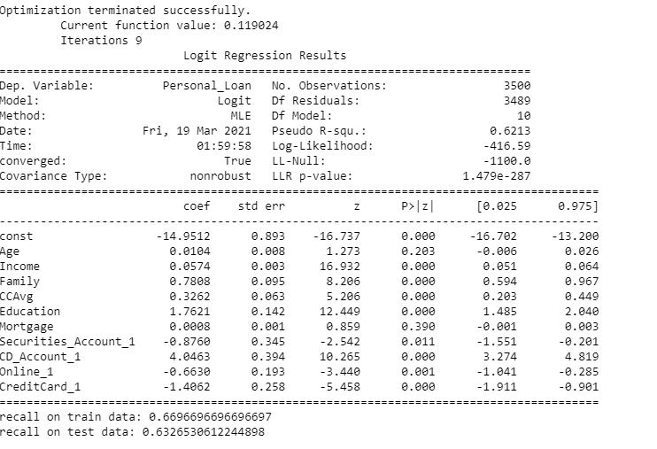
Logistic Regression Model using Stats Model:
Observations:
Mortgage has p-value 0.096 which is > 0.05, which is insignificant.
Will drop the ‘Mortgage’ variable and build the model again.

Slide 21
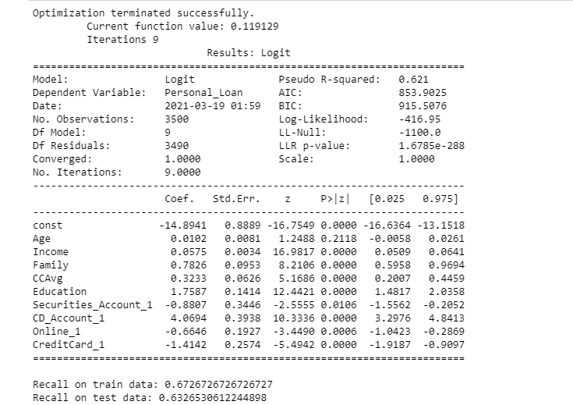
Logistic Regression Model using Stats Model:
Observations:
Recall has improved a bit so model ‘lg1’ is good for making interpretations.
As per lg1, Age, Income, Family, CCAvg, Education, Securities_Account, CD_Account, Online and CreditCard are important variables here.
Securities_Account, Online and Credit card variables have negative signs, i.e. Increase in these will lead to an decrease in chances of accepting the loan by default.

Slide 22
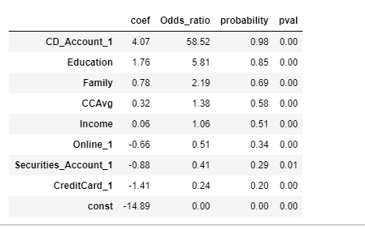
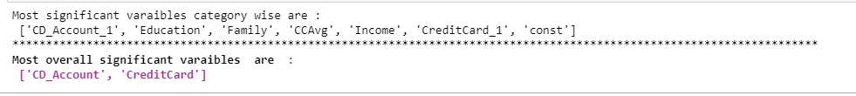
Logistic Regression Model using Stats Model:
Most significant Variables

Slide 23
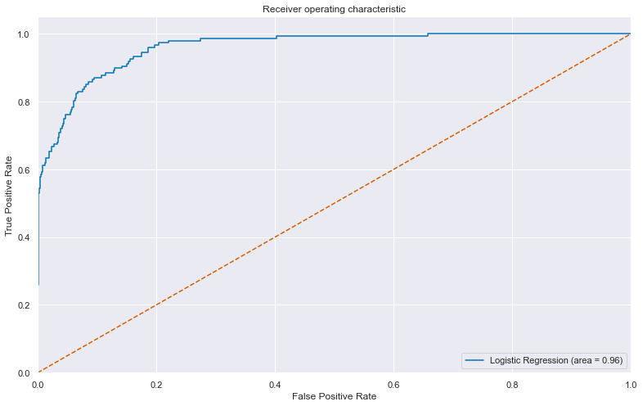
Logistic Regression Model using Stats Model:
Prediction of Model
Prediction on train data:
Accuracy on train data: 0.9577142857142857
Accuracy on test data: 0.952
Recall on train data: 0.6726726726726727
Recall on test data: 0.6326530612244898
Precision on train data: 0.8517110266159695
Precision on test data: 0.8378378378378378
f1 score on train data: 0.7516778523489932
f1 score on test data: 0.7209302325581396
Recall has improved to quite good extent after AUC-ROC curve
Accuracy on train data: 0.904
Accuracy on test data: 0.8986666666666666
Recall on train data: 0.9039039039039038
Recall on test data: 0.8571428571428571
Precision on train data: 0.4975206611570248
Precision on test data: 0.490272373540856
f1 score on train data: 0.6417910447761194
f1 score on test data: 0.6237623762376238

Slide 24
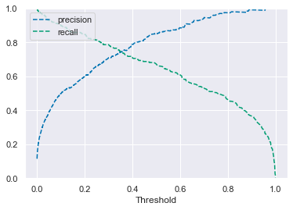
Logistic Regression Model using Stats Model:
Precision-Recall curve to see if we can find a better threshold
Observations:
Decreasing threshold beyond 0.3 will lead to fast decrease in Precision, which will lead to great loss of opportunity, so let's consider threshold of 0.3.

Slide 25
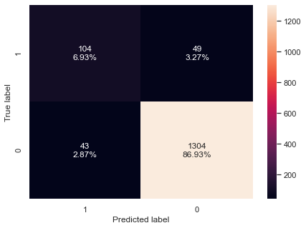
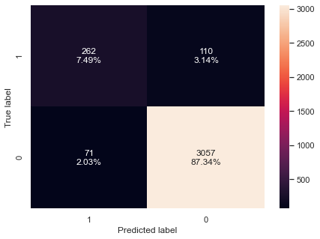
Logistic Regression Model using Stats Model:
Confusion matrix on train set
Confusion matrix on test set

Slide 26
Logistic Regression Model using Stats Model:
Insights:
The accuracy after using precision-recall curve has decreased from 85.7% to 70.7%
After choosing optimal threshold using AUC-ROC we see 8.67% as true positives
Six Most important variables from SFS methods are:
- CD_Account_1
- Education
- Family
- CCAvg
- Income
- CreditCard_1
Conclusion:
The logistic regression model with multicollinearity removed is best model.

Slide 27
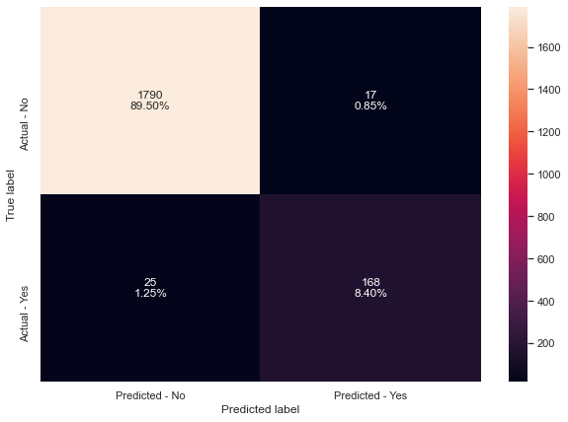
Decision Tree Model
Built model using Decision Tree classifier function using default ‘Gini’ criteria to split.
Confusion Matrix on Train set
Observations:
Accuracy on train set is 1.0
Accuracy on test set is 0.979
Recall score on train set is 1.0
Recall score on test set 0.8705
Recall on training and test set is very good.

Slide 28
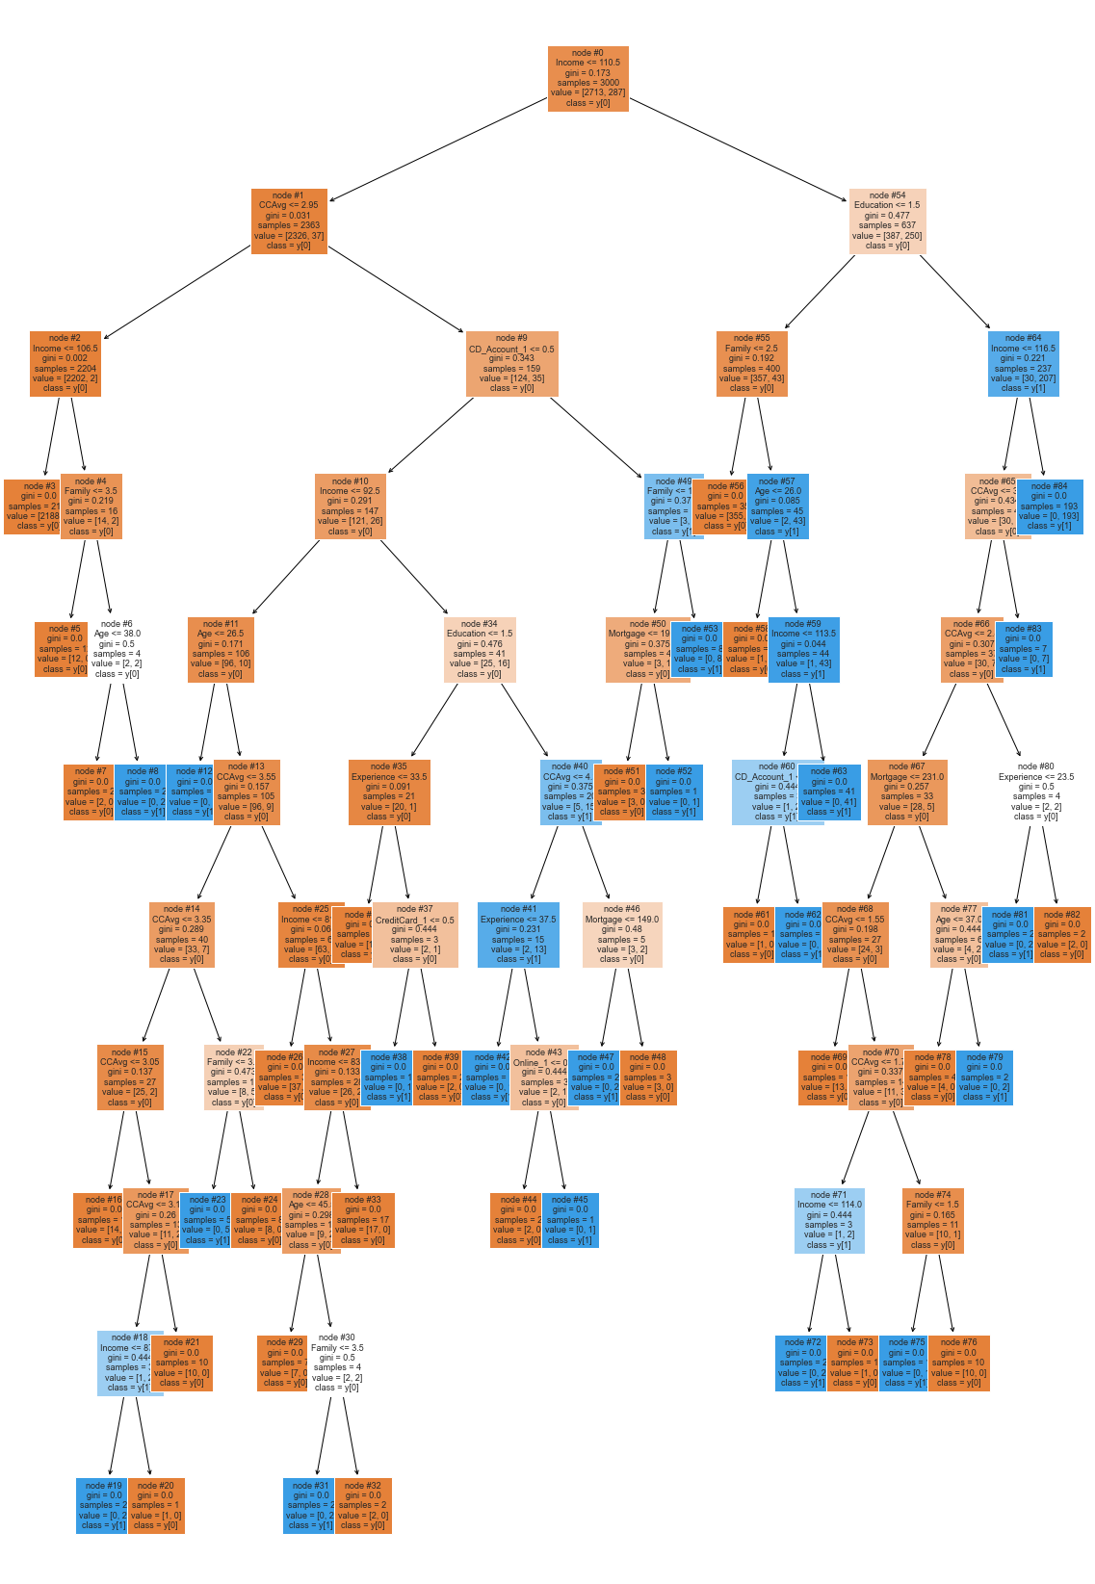
Decision Tree Model
Visualizing the Decision Tree

Slide 29
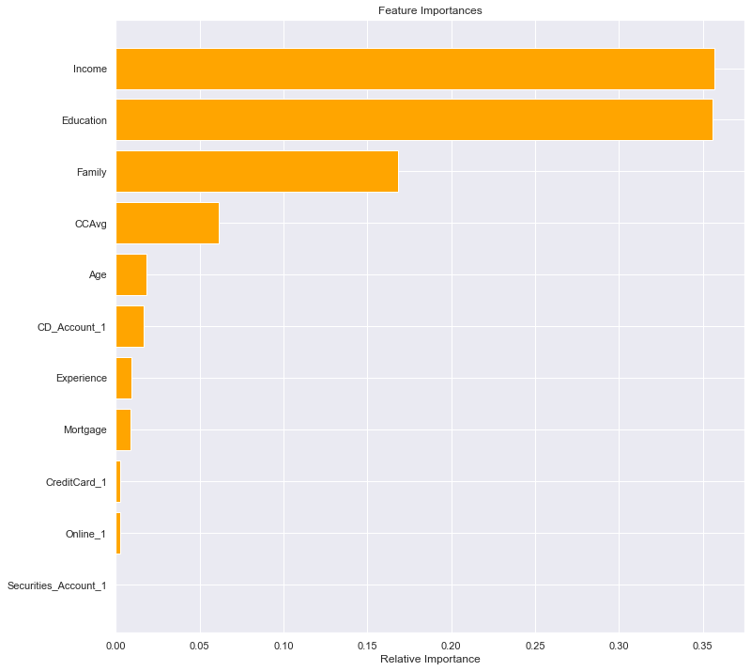
Decision Tree Model
Feature Importance's
Observations:
Income, Education and Family are the top 3 important features.

Slide 30
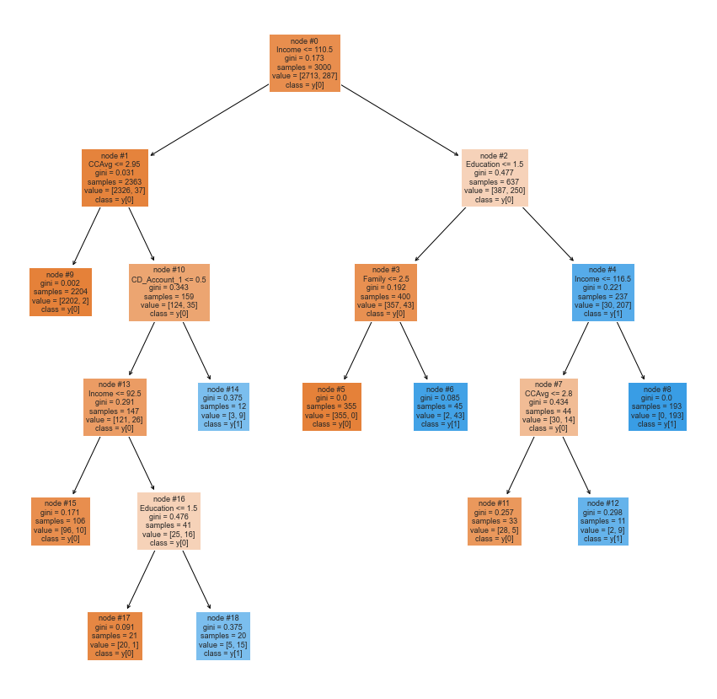
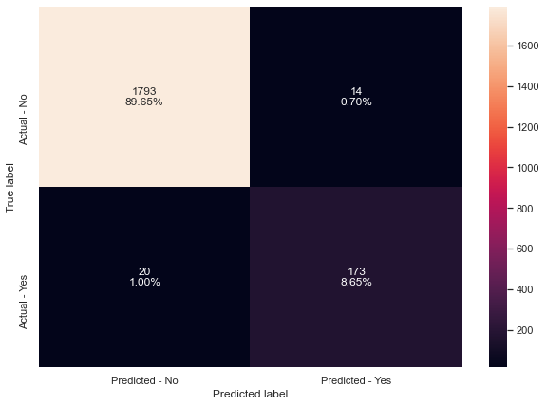
Decision Tree Model
Grid Search for Hyperparameter tuning to tree model
Observations:
Recall on train set is 0.94
Recall on test set 0.896

Slide 31
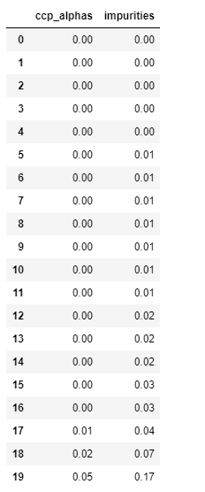
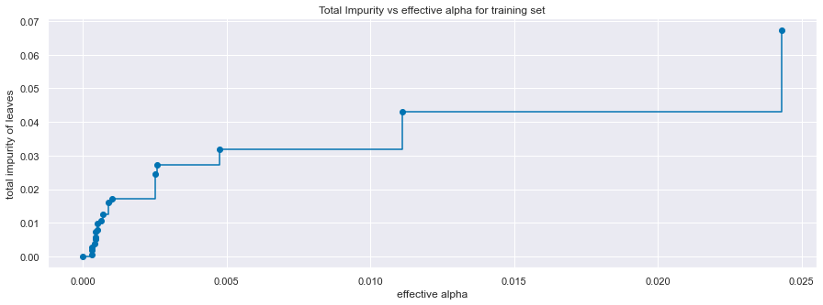
Decision Tree Model
Cost complexity pruning
Total impurity leaves VS Effective Alpha

Slide 32
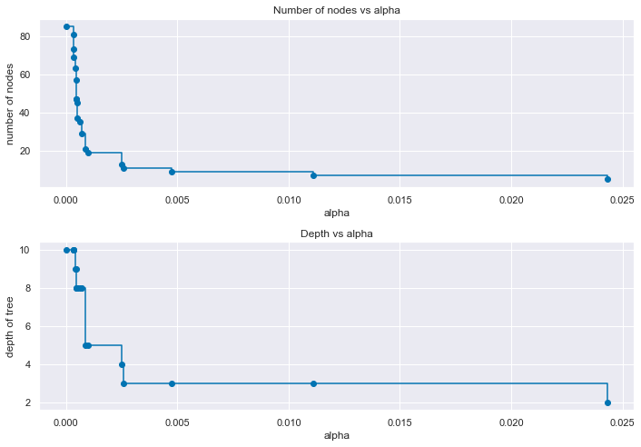
Decision Tree Model
Observations:
Recall on train set is 0.94
Recall on test set 0.896

Slide 33
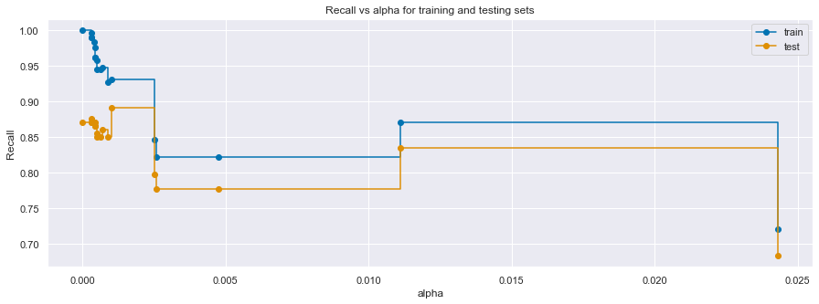
Decision Tree Model
Recall VS Alpha for training and test sets
Observations:
Recall on train set is 0.94
Recall on test set 0.896

Slide 34
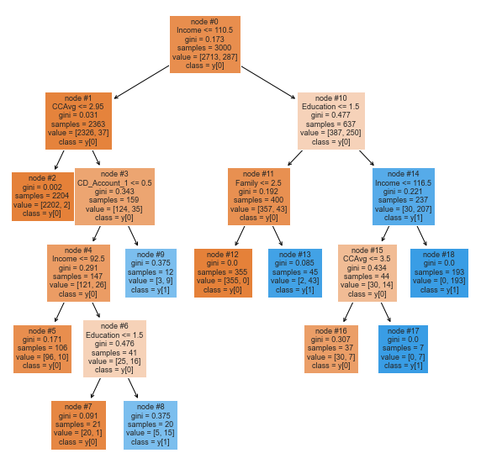

Decision Tree Model
Confusion matrix & Tree
Observations:
Recall on train set is 0.94
Recall on test set 0.896

Slide 35


Decision Tree Model
Important features in tree building
Observations:

Slide 36

Decision Tree Model
Comparing all the decision tree models
Observations:
Decision tree with post-pruning is giving the highest recall on the test set, even though we got recall as 1 with hyperparameter tuning but that model wasn't a generalized one

Slide 37
Conclusion:
Analyzed the "All Life Bank personal loan acceptance" using different techniques and used Decision Tree Classifier to build a predictive model for the same.
The model built can be used to predict if a customer is going to accept default personal loan or not.
Visualized different trees and their confusion matrix to get a better understanding of the model. Easy interpretation is one of the key benefits of Decision Trees.
Verified the fact that how much less data preparation is needed for Decision Trees and such a simple model gave good results even with outliers and imbalanced classes which shows the robustness of Decision Trees.
Education, Income, Family, CCAvg and CD_Account are the most important variable in predicting the customers that will accept the default personal loan.
Established the importance of hyper-parameters/ pruning to reduce overfitting.

Slide 38
Recommendations:
According to the decision tree model -
a) If a customer Income < 92.5K there's a very high chance the customer will not accept the personal loan.
b) If a customer Income < 92.5K and CCAvg > 2.95k per month then there is a very high chance that the customer is going to accept the personal loan.
It is observed that the customers with family size of 3 are more likelihood of them accepting the personal loan than other family sizes.
Offer best interest rates on loans to the customers to attract more.

